Slide 1
Chapter 10:
Classes and Data Abstraction

Slide 2
Objectives
In this chapter, you will:
Learn about classes
Learn about private, protected, and public members of a class
Implement classes
Examine constructors and destructors
Learn about the abstract data type (ADT)
C++ Programming: From Problem Analysis to Program Design, Sixth Edition

Slide 3
Objectives (cont’d.)
Use classes to implement ADTs
Learn about information hiding
Implement information hiding in C++
Learn about the static members of a class
C++ Programming: From Problem Analysis to Program Design, Sixth Edition

Slide 4
Classes
Object-oriented design (OOD): a problem solving methodology
Objects: components of a solution
Class: a collection of a fixed number of components
Member: a component of a class
C++ Programming: From Problem Analysis to Program Design, Sixth Edition
Notes:
Chapter 1 introduced the problem-solving methodology called object-oriented design (OOD). In OOD, the first step is to identify the components, called objects. An object combines data and the operations on that data in a single unit. In C++, the mechanism that allows you to combine data and the operations on that data in a single unit is called a class. Now that you know how to store and manipulate data in computer memory and how to construct your own functions, you are ready to learn how objects are constructed.
This and subsequent chapters develop and implement programs using OOD. This chapter first explains how to define a class and use it in a program.
A class is a collection of a fixed number of components. The components of a class are called the members of the class
Chapter 1 introduced the problem-solving methodology called object-oriented design (OOD). In OOD, the first step is to identify the components, called objects. An object combines data and the operations on that data in a single unit. In C++, the mechanism that allows you to combine data and the operations on that data in a single unit is called a class. Now that you know how to store and manipulate data in computer memory and how to construct your own functions, you are ready to learn how objects are constructed. This and subsequent chapters develop and implement programs using OOD.

Slide 5
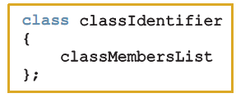
Classes (cont’d.)
Class definition:
  Defines a data type; no memory is allocated
  Don’t forget the semicolon after the closing brace
Syntax:
C++ Programming: From Problem Analysis to Program Design, Sixth Edition
Notes:
The general syntax for defining a class is:
class classIdentifier
{
classMembersList
};
in which classMembersList consists of variable declarations and/or functions. That is, a member of a class can be either a variable (to store data) or a function.
•If a member of a class is a variable, you declare it just like any other
variable. Also, in the definition of the class, you cannot initialize a
variable when you declare it.
• If a member of a class is a function, you typically use the function
prototype to declare that member.
• If a member of a class is a function, it can (directly) access any member of the
class—member variables and member functions. That is, when you write
the definition of a member function, you can directly access any member
variable of the class without passing it as a parameter. The only obvious
condition is that you must declare an identifier before you can use it.

Slide 6
Classes (cont’d.)
Class member can be a variable or a function
If a member of a class is a variable
  It is declared like any other variable
  You cannot initialize a variable when you declare it
If a member of a class is a function
  Function prototype is listed
  Function members can (directly) access any member of the class
C++ Programming: From Problem Analysis to Program Design, Sixth Edition

Slide 7
Classes (cont’d.)
Three categories of class members:
  private (default)
    Member cannot be accessed outside the class
  public
    Member is accessible outside the class
  protected
C++ Programming: From Problem Analysis to Program Design, Sixth Edition

Slide 8
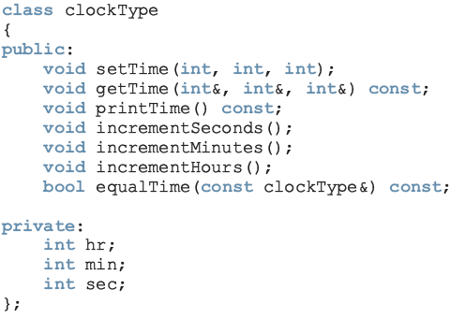
Classes (cont'd.)
const: formal parameter can’t modify
the value of the actual parameter
These functions cannot modify the member variables of a variable of type clockType
private members,
can’t be accessed from outside the class
C++ Programming: Program Design Including Data Structures, Fifth Edition
Notes:
Suppose that we want to define a class to implement the time of day in a program. Because a clock gives the time of day, let us call this class clockType. Furthermore, to represent time in computer memory, we use three int variables: one to represent the hours, one to represent the minutes, and one to represent the seconds.
Suppose these three variables are: int hr; int min; int sec;
We also want to perform the following operations on the time:
1. Set the time. 2. Retrieve the time. 3. Print the time. 4. Increment the time by one second. 5. Increment the time by one minute. 6. Increment the time by one hour. 7. Compare the two times for equality

Slide 9
Unified Modeling Language
Class Diagrams
Unified Modeling Language (UML) notation: used to graphically describe a class and its members
  +: member is public
  -: member is private
  #: member is protected
C++ Programming: From Problem Analysis to Program Design, Sixth Edition

Slide 10
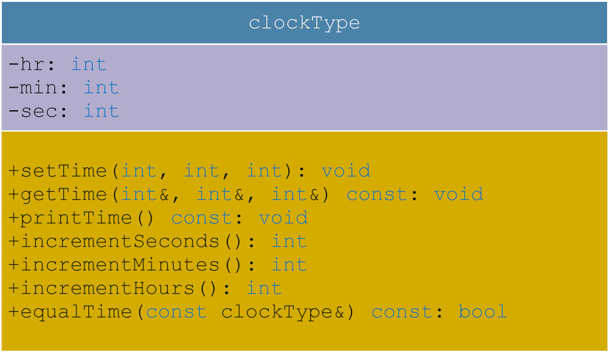
Unified Modeling Language Class Diagrams (cont’d.)
C++ Programming: From Problem Analysis to Program Design, Sixth Edition

Slide 11
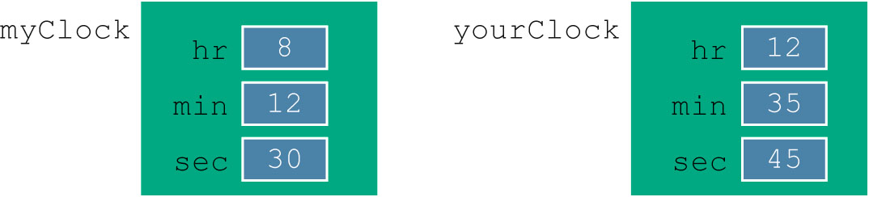
Variable (Object) Declaration
Once defined, you can declare variables of that class type
clockType myClock;
A class variable is called a class object or class instance
C++ Programming: From Problem Analysis to Program Design, Sixth Edition

Slide 12

Accessing Class Members
Once an object is declared, it can access the public members of the class
Syntax:
  The dot (.) is the member access operator
If an object is declared in the definition of a member function of the class, it can access the public and private members
C++ Programming: From Problem Analysis to Program Design, Sixth Edition

Slide 13
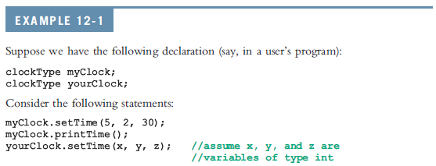


Accessing Class Members (cont’d.)
C++ Programming: Program Design Including Data Structures, Fifth Edition

Slide 14
Built-in Operations on Classes
Most of C++’s built-in operations do not apply to classes
  Arithmetic operators cannot be used on class objects unless the operators are overloaded
  Cannot use relational operators to compare two class objects for equality
Built-in operations that are valid for class objects:
  Member access (.)
  Assignment (=)
C++ Programming: From Problem Analysis to Program Design, Sixth Edition

Slide 15
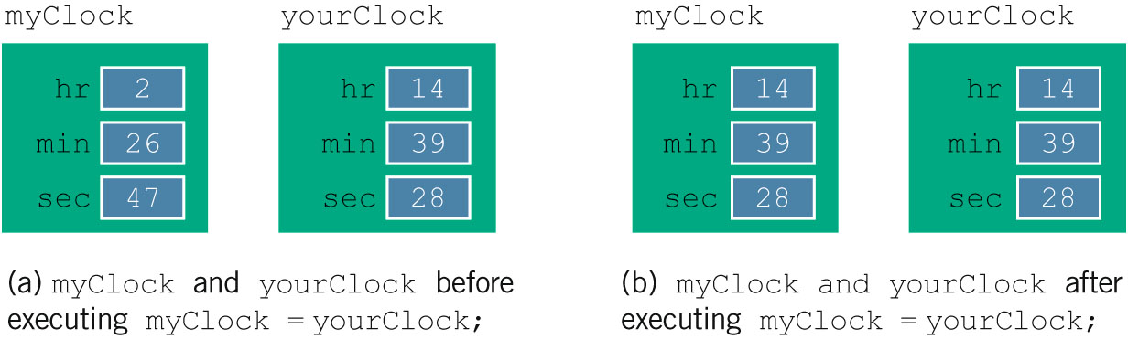
Assignment Operator and Classes
C++ Programming: From Problem Analysis to Program Design, Sixth Edition

Slide 16
Class Scope
An object can be automatic or static
  Automatic: created when the declaration is reached and destroyed when the surrounding block is exited
  Static: created once when the declaration is reached and destroyed when the program terminates
Object has the same scope as other variables
C++ Programming: From Problem Analysis to Program Design, Sixth Edition

Slide 17
Class Scope (cont’d.)
A member of the class is local to the class
Can access a class member outside the class by using the class object name and the member access operator (.)
C++ Programming: From Problem Analysis to Program Design, Sixth Edition

Slide 18
Functions and Classes
Objects can be passed as parameters to functions and returned as function values
As parameters to functions
  Objects can be passed by value or by reference
If an object is passed by value
  Contents of data members of the actual parameter are copied into the corresponding data members of the formal parameter
C++ Programming: From Problem Analysis to Program Design, Sixth Edition

Slide 19
Reference Parameters and Class Objects (Variables)
Passing by value might require a large amount of storage space and a considerable amount of computer time to copy the value of the actual parameter into the formal parameter
If a variable is passed by reference
  The formal parameter receives only the address of the actual parameter
C++ Programming: From Problem Analysis to Program Design, Sixth Edition

Slide 20
Reference Parameters and Class Objects (Variables) (cont’d.)
Pass by reference is an efficient way to pass a variable as a parameter
  Problem: when passing by reference, the actual parameter changes when formal parameter changes
  Solution: use const in the formal parameter declaration
C++ Programming: From Problem Analysis to Program Design, Sixth Edition

Slide 21
Implementation of Member Functions
Must write the code for functions defined as function prototypes
Prototypes are left in the class to keep the class smaller and to hide the implementation
To access identifiers local to the class, use the scope resolution operator ::
C++ Programming: From Problem Analysis to Program Design, Sixth Edition

Slide 22
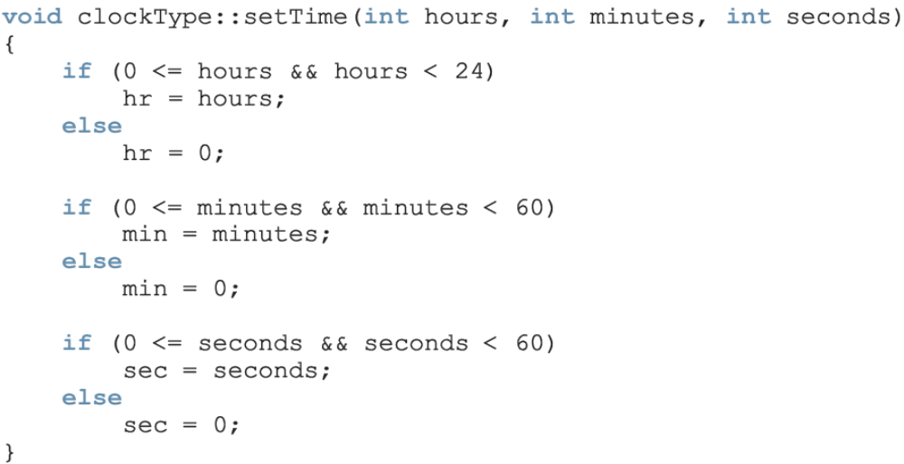
Implementation of Member Functions
Scope resolution operator
C++ Programming: Program Design Including Data Structures, Fifth Edition

Slide 23
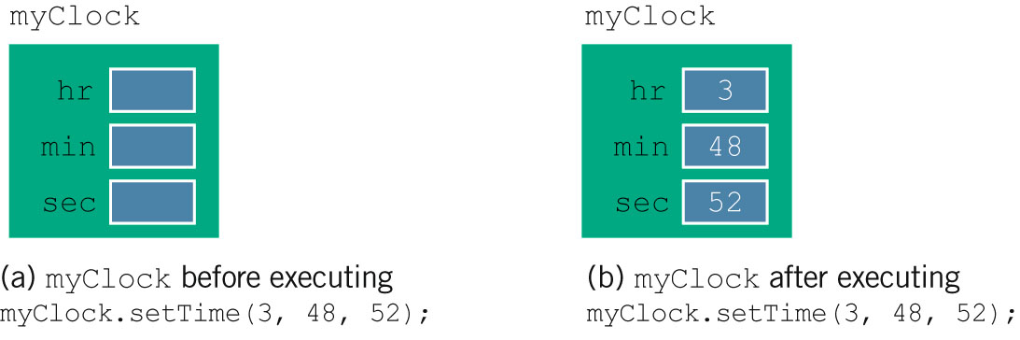
Implementation of Member Functions (cont’d.)
C++ Programming: From Problem Analysis to Program Design, Sixth Edition

Slide 24
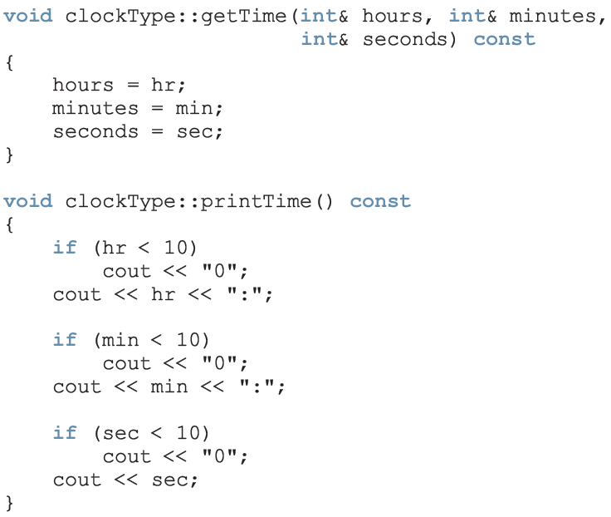
Implementation of Member Functions (cont'd.)
C++ Programming: Program Design Including Data Structures, Fifth Edition

Slide 25
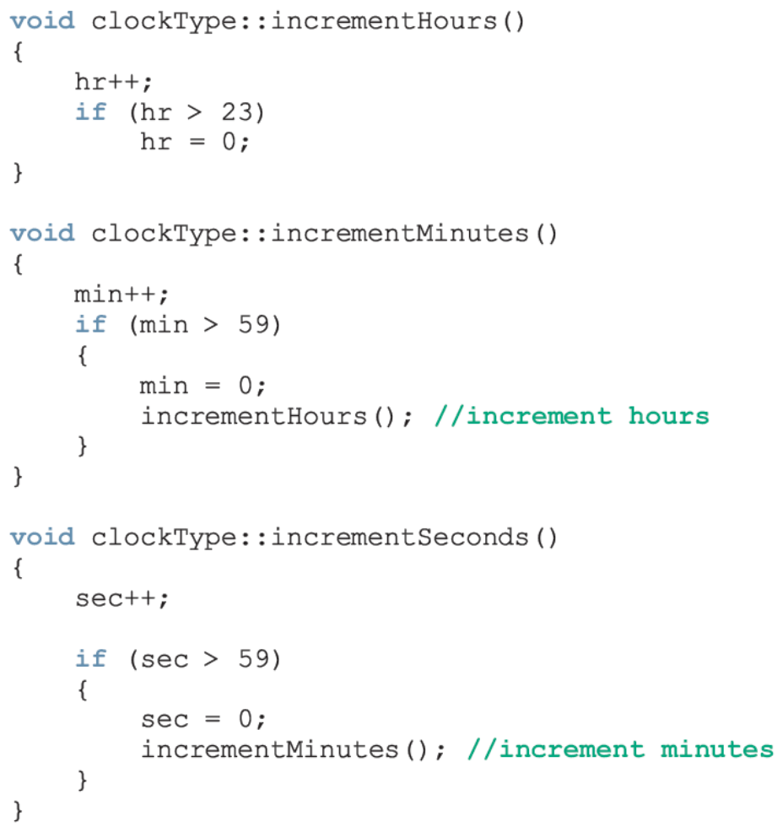
Implementation of Member Functions (cont'd.)
C++ Programming: Program Design Including Data Structures, Fifth Edition

Slide 26
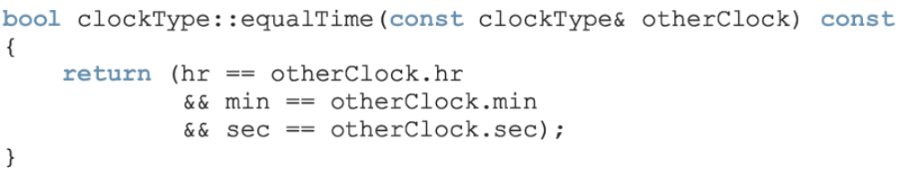
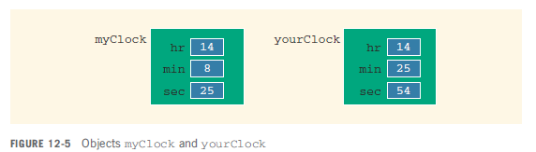
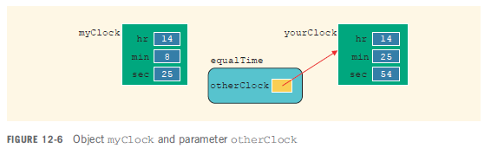
Implementation of Member Functions (cont'd.)
C++ Programming: Program Design Including Data Structures, Fifth Edition

Slide 27
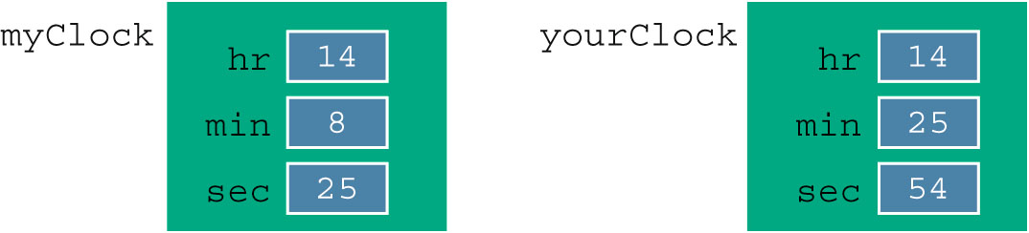

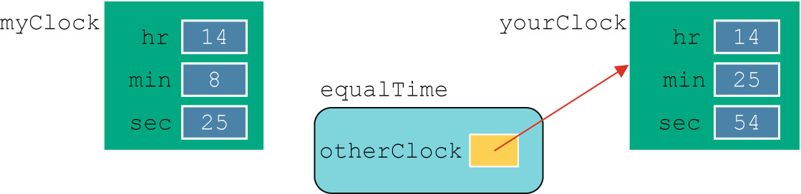
Implementation of Member Functions (cont’d.)
C++ Programming: From Problem Analysis to Program Design, Sixth Edition

Slide 28
Implementation of Member Functions (cont’d.)
Once a class is properly defined and implemented, it can be used in a program
  A program that uses/manipulates objects of a class is called a client of that class
When you declare objects of the class clockType, each object has its own copy of the member variables (hr, min, and sec)
  Called instance variables of the class
  Every object has its own instance of the data
C++ Programming: From Problem Analysis to Program Design, Sixth Edition

Slide 29
Accessor and Mutator Functions
Accessor function: member function that only accesses the value(s) of member variable(s)
Mutator function: member function that modifies the value(s) of member variable(s)
Constant function:
  Member function that cannot modify member variables
  Use const in function heading
C++ Programming: From Problem Analysis to Program Design, Sixth Edition

Slide 30
Order of public and private Members of a Class
C++ has no fixed order in which to declare public and private members
By default, all members of a class are private
Use the member access specifier public to make a member available for public access
C++ Programming: From Problem Analysis to Program Design, Sixth Edition

Slide 31
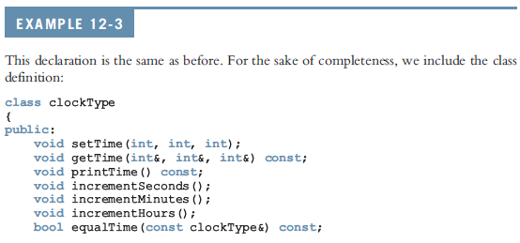
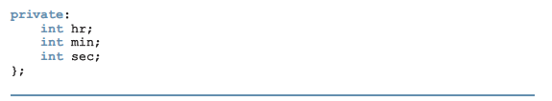
Order of public and private Members of a Class (cont'd.)
C++ Programming: Program Design Including Data Structures, Fifth Edition

Slide 32
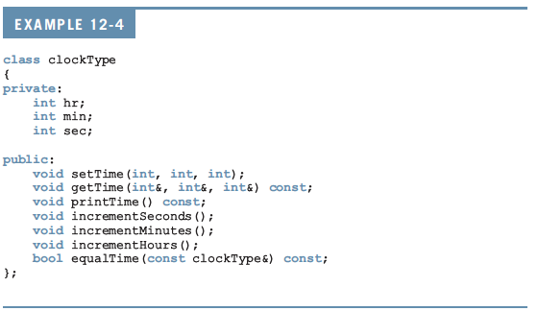
Order of public and private Members of a Class (cont'd.)
C++ Programming: Program Design Including Data Structures, Fifth Edition

Slide 33
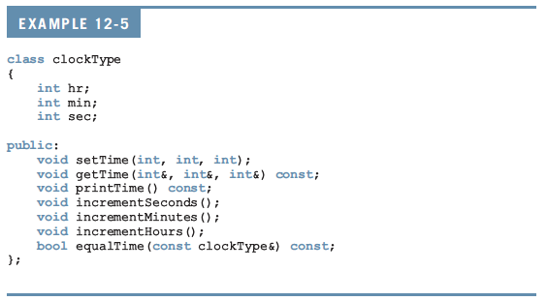
Order of public and private Members of a Class (cont'd.)
C++ Programming: Program Design Including Data Structures, Fifth Edition

Slide 34
Constructors
Use constructors to guarantee that member variables of a class are initialized
Two types of constructors:
  With parameters
  Without parameters (default constructor)
  Name of a constructor = name of the class
  A constructor has no type
C++ Programming: From Problem Analysis to Program Design, Sixth Edition

Slide 35
Constructors (cont’d.)
A class can have more than one constructor
  Each must have a different formal parameter list
Constructors execute automatically when a class object enters its scope
They cannot be called like other functions
Which constructor executes depends on the types of values passed to the class object when the class object is declared
C++ Programming: From Problem Analysis to Program Design, Sixth Edition

Slide 36
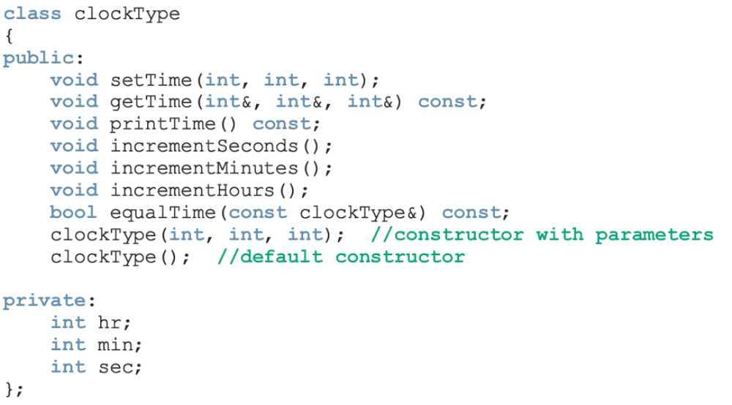
Constructors (cont'd.)
C++ Programming: Program Design Including Data Structures, Fifth Edition

Slide 37
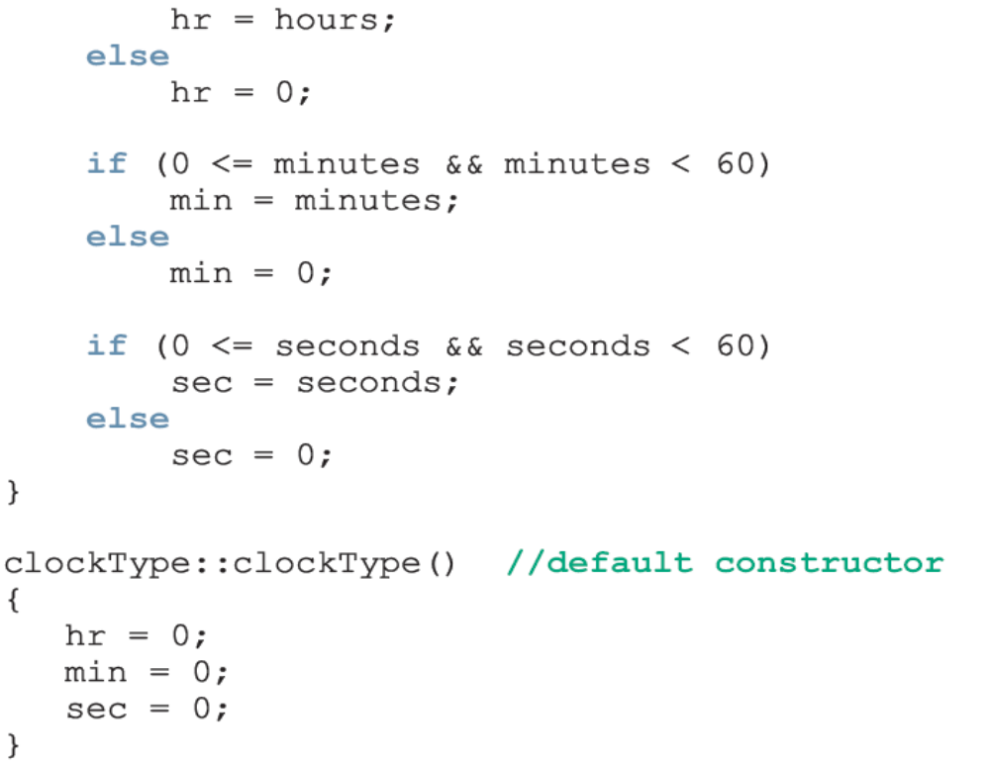
Constructors (cont'd.)
Can be replaced with:
setTime(hours, minutes, seconds);
C++ Programming: Program Design Including Data Structures, Fifth Edition

Slide 38
Invoking a Constructor
A constructor is automatically executed when a class variable is declared
Because a class may have more than one constructor, you can invoke a specific constructor
C++ Programming: From Problem Analysis to Program Design, Sixth Edition

Slide 39

Invoking the Default Constructor
To invoke the default constructor:
Example:
clockType yourClock;
C++ Programming: From Problem Analysis to Program Design, Sixth Edition

Slide 40
Invoking a Constructor with Parameters
Syntax:
Number and type of arguments should match the formal parameters (in the order given) of one of the constructors
  Otherwise, C++ uses type conversion and looks for the best match
  Any ambiguity causes a compile-time error
C++ Programming: From Problem Analysis to Program Design, Sixth Edition

Slide 41
Constructors and Default Parameters
A constructor can have default parameters
  Rules for declaring formal parameters are the same as for declaring default formal parameters in a function
  Actual parameters are passed according to same rules for functions
Default constructor: a constructor with no parameters or with all default parameters
C++ Programming: From Problem Analysis to Program Design, Sixth Edition
Notes:
If you do not specify the value of a default parameter, the default value is used for that parameter.
All of the default parameters must be the far-right parameters of the function.
Suppose a function has more than one default parameter. In a function call, if a value to a default parameter is not specified, then you must omit all of the arguments to its right.
Default values can be constants, global variables, or function calls.
The caller has the option of specifying a value other than the default for any default parameter.
You cannot assign a constant value as a default value to a reference parameter.

Slide 42
Constructors and Default Parameters
If you replace the constructors of clockType with the constructor in Line 1, you can declare clockType objects with zero, one, two, or three arguments as follows:
  clockType clock1; //Line 2
  clockType clock2(5); //Line 3
  clockType clock3(12, 30); //Line 4
  clockType clock4(7, 34, 18); //Line 5
C++ Programming: Program Design Including Data Structures, Fifth Edition

Slide 43
Classes and Constructors: A Precaution
If a class has no constructor(s), C++ provides the default constructor
  However, object declared is still uninitialized
If a class includes constructor(s) with parameter(s), but not the default constructor
  C++ does not provide the default constructor
C++ Programming: From Problem Analysis to Program Design, Sixth Edition

Slide 44
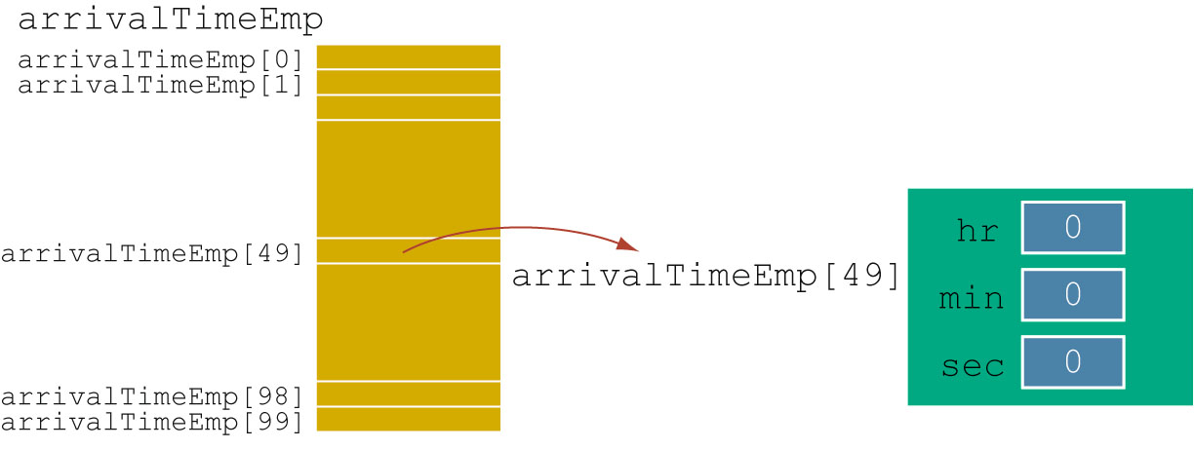
Arrays of Class Objects (Variables) and Constructors
If you declare an array of class objects, the class should have the default constructor
C++ Programming: From Problem Analysis to Program Design, Sixth Edition

Slide 45
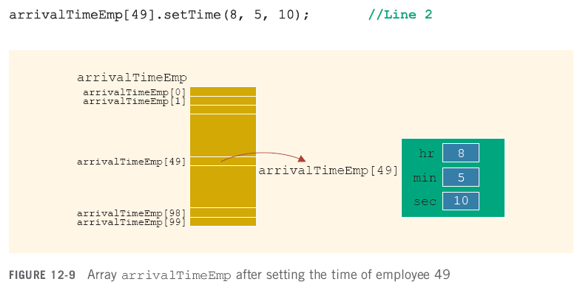
Arrays of Class Objects (Variables) and Constructors (cont'd.)
C++ Programming: Program Design Including Data Structures, Fifth Edition

Slide 46
Destructors
Destructors are functions without any type
The name of a destructor is the character '~' followed by class name
  For example:
~clockType();
A class can have only one destructor
  The destructor has no parameters
Destructor automatically executes when the class object goes out of scope
C++ Programming: From Problem Analysis to Program Design, Sixth Edition

Slide 47
Data Abstract, Classes,
and Abstract Data Types
Abstraction
  Separating design details from usage
  Separating the logical properties from the implementation details
Abstraction can also be applied to data
Abstract data type (ADT): data type that separates the logical properties from the implementation details
C++ Programming: From Problem Analysis to Program Design, Sixth Edition

Slide 48
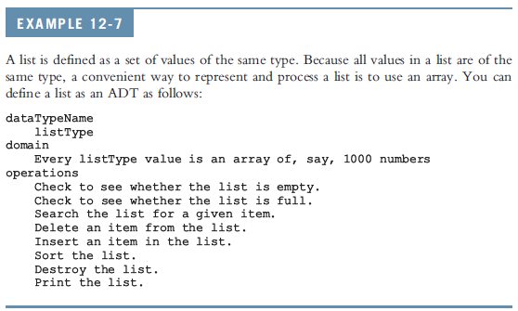
Data Abstract, Classes, and Abstract Data Types (cont'd.)
C++ Programming: Program Design Including Data Structures, Fifth Edition

Slide 49
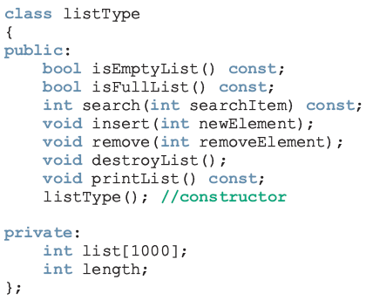
Data Abstract, Classes, and Abstract Data Types (cont'd.)
C++ Programming: Program Design Including Data Structures, Fifth Edition

Slide 50
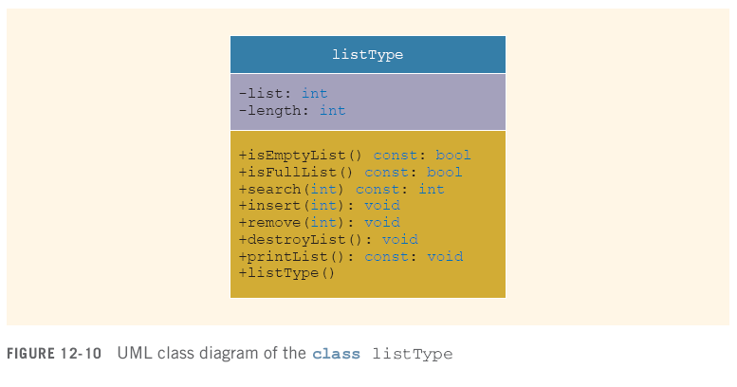
Data Abstract, Classes, and Abstract Data Types (cont'd.)
C++ Programming: Program Design Including Data Structures, Fifth Edition

Slide 51
A struct Versus a class
By default, members of a struct are public
  private specifier can be used in a struct to make a member private
By default, the members of a class are private
classes and structs have the same capabilities
C++ Programming: From Problem Analysis to Program Design, Sixth Edition

Slide 52
A struct Versus a class (cont’d.)
In C++, the definition of a struct was expanded to include member functions, constructors, and destructors
If all member variables of a class are public and there are no member functions
  Use a struct
C++ Programming: From Problem Analysis to Program Design, Sixth Edition

Slide 53
Information Hiding
Information hiding: hiding the details of the operations on the data
Interface (header) file: contains the specification details
  File extension is .h
Implementation file: contains the implementation details
  File extension is .cpp
In header file, include function prototypes and comments that briefly describe the functions
  Specify preconditions and/or postconditions
C++ Programming: From Problem Analysis to Program Design, Sixth Edition

Slide 54
Information Hiding (cont’d.)
Implementation file must include header file via include statement
In include statement:
  User-defined header files are enclosed in double quotes
  System-provided header files are enclosed between angular brackets
C++ Programming: From Problem Analysis to Program Design, Sixth Edition

Slide 55
Information Hiding (cont'd.)
Precondition: A statement specifying the condition(s) that must be true before the function is called
Postcondition: A statement specifying what is true after the function call is completed
C++ Programming: From Problem Analysis to Program Design, Sixth Edition

Slide 56
Executable Code
To use an object in a program
  The program must be able to access the implementation
Visual C++, Visual Studio .NET, C++ Builder, and CodeWarrior put the editor, compiler, and linker into a package
  One command (build, rebuild, or make) compiles program and links it with the other necessary files
  These systems also manage multiple file programs in the form of a project
C++ Programming: From Problem Analysis to Program Design, Sixth Edition

Slide 57
Static Members of a Class
Use the keyword static to declare a function or variable of a class as static
A public static function or member of a class can be accessed using the class name and the scope resolution operator
static member variables of a class exist even if no object of that class type exists
C++ Programming: From Problem Analysis to Program Design, Sixth Edition

Slide 58
Static Members of a Class (cont’d.)
Multiple objects of a class each have their own copy of non-static member variables
All objects of a class share any static member of the class
C++ Programming: From Problem Analysis to Program Design, Sixth Edition

Slide 59
Programming Example: Candy Machine
A common place to buy candy is a candy machine
This candy machine currently sells candies, chips, gum, and cookies
A new candy machine is bought for the gym, but it is not working properly
You have been asked to write a program so it can be put into operation
C++ Programming: Program Design Including Data Structures, Fifth Edition

Slide 60
Programming Example: Candy Machine (cont'd.)
The program should:
  Show the customer the different products sold
  Let the customer make the selection
  Show the customer the cost of the item
  Accept money from the customer
  Release the item
Input: item selection and cost of the item
Output: selected item
C++ Programming: Program Design Including Data Structures, Fifth Edition

Slide 61
Programming Example: Problem Analysis
A candy machine has two main components:
  A built-in cash register
  Several dispensers to hold and release the product
C++ Programming: Program Design Including Data Structures, Fifth Edition

Slide 62
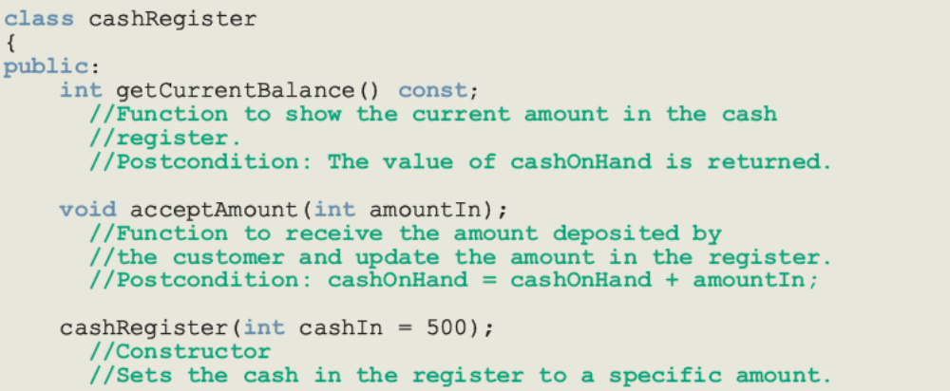
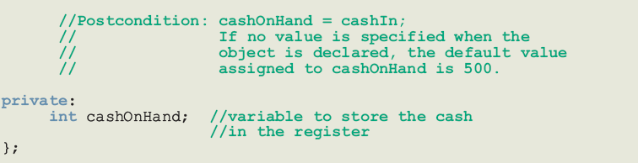
Programming Example: Problem Analysis (cont’d.)
C++ Programming: Program Design Including Data Structures, Fifth Edition

Slide 63
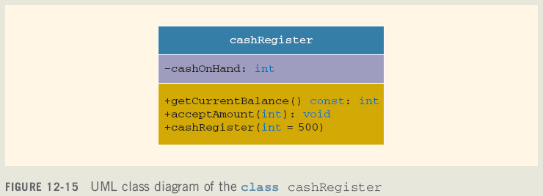
Programming Example: Problem Analysis (cont’d.)
C++ Programming: Program Design Including Data Structures, Fifth Edition

Slide 64
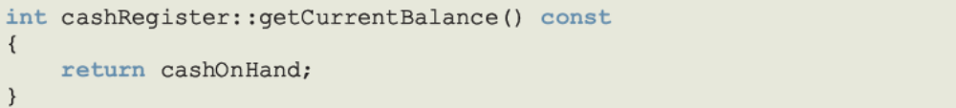
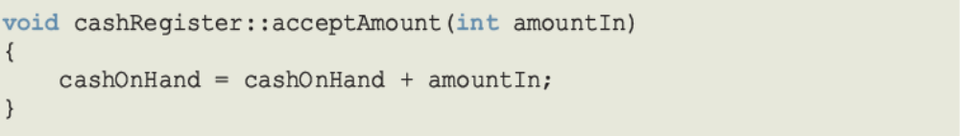
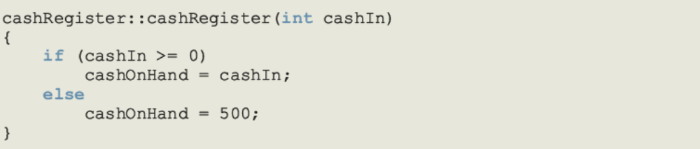
Programming Example: Problem Analysis (cont’d.)
C++ Programming: Program Design Including Data Structures, Fifth Edition

Slide 65
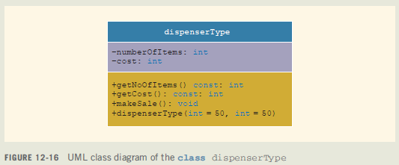
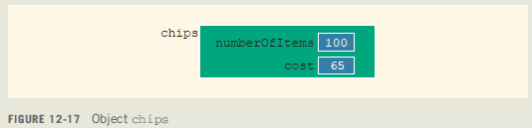
Programming Example: Problem Analysis (cont'd.)
C++ Programming: Program Design Including Data Structures, Fifth Edition

Slide 66
Programming Example: Main Program
When the program executes, it must:
  Show the different products sold
  Show how to select a particular product
  Show how to terminate the program
These instructions must be displayed after processing each selection
Once the user has made a selection
  Candy machine must act accordingly
C++ Programming: Program Design Including Data Structures, Fifth Edition

Slide 67
Programming Example: Main Program (cont'd.)
If the user wants to a buy a product and the product is available
  Candy machine should show product cost and ask the user to deposit money
If the money deposited is at least the cost of the item
  Candy machine should sell the item and display an appropriate message
C++ Programming: Program Design Including Data Structures, Fifth Edition

Slide 68
Programming Example: showSelection
Show the selection to the customer
Get selection
If selection is valid and the dispenser corresponding to the selection is not empty, sell the product
C++ Programming: Program Design Including Data Structures, Fifth Edition

Slide 69
Programming Example: sellProduct
If the dispenser is nonempty:
  Prompt customer to enter the item cost
  Get the amount entered by the customer
  If the amount entered by the customer is less than the cost of the product
    Prompt customer to enter additional amount
    Calculate total amount entered by the customer
C++ Programming: Program Design Including Data Structures, Fifth Edition

Slide 70
Programming Example: sellProduct (cont'd.)
  If amount entered by the customer is at least the cost of the product
    Update the amount in the cash register
    Sell the product; that is, decrement the number of items in the dispenser by 1
    Display an appropriate message
  If amount entered is less than cost of item
    Return the amount
  If the dispenser is empty
    Tell the user that this product is sold out
C++ Programming: Program Design Including Data Structures, Fifth Edition

Slide 71
Programming Example: main
Declare a variable of type cashRegister
Declare and initialize four objects dispenserType
For example:
  The statement
  dispenserType candy(100, 50);
  creates a dispenser object, candy, to hold candies; the number of items in the dispenser is 100 and the cost of an item is 50 cents
C++ Programming: Program Design Including Data Structures, Fifth Edition

Slide 72
Programming Example: main (cont'd.)
Declare additional variables as necessary
Show menu
Get the selection
While not done (9 exits)
  Sell product (sellProduct)
  Show selection (showSelection)
  Get selection
C++ Programming: Program Design Including Data Structures, Fifth Edition

Slide 73
Summary
Class: collection of a fixed number of components
Members: components of a class
  Accessed by name
  Classified into one of three categories:
    private, protected, and public
Class variables are called class objects or, simply, objects
C++ Programming: From Problem Analysis to Program Design, Sixth Edition

Slide 74
Summary (cont’d.)
The only built-in operations on classes are assignment and member selection
Constructors guarantee that data members are initialized when an object is declared
  Default constructor has no parameters
Destructor automatically executes when a class object goes out of scope
  A class can have only one destructor
  The destructor has no parameters
C++ Programming: From Problem Analysis to Program Design, Sixth Edition

Slide 75
Summary (cont’d.)
Abstract data type (ADT): data type that separates the logical properties from the implementation details
A public static member, function or data, of a class can be accessed using the class name and the scope resolution operator
Static data members of a class exist even when no object of the class type exists
Instance variables: non-static data members
C++ Programming: From Problem Analysis to Program Design, Sixth Edition

